Slide 1
Convolution Hardware Accelerator
Oscar Kellner

Slide 2
Goals
This is a ‘joint’ project between this class and Microprocessor-Based Design (“MBD”)
Overall goal is to create a hardware accelerator for the convolution algorithm within a convolutional neural network, and embed it within an existing machine learning framework.
On MBD-side, the framework must be modified in order to interface with the hardware.
Darknet was chosen as it was written in C and is open-source, potentially making it ideal for use within an embedded system.
As a result, many of the design decisions for the accelerator were centered around making it convenient for Darknet to read and write to the accelerator’s streaming interfaces.
HW drives convolution, SW converts image into data and loads to/from buffers

Slide 3
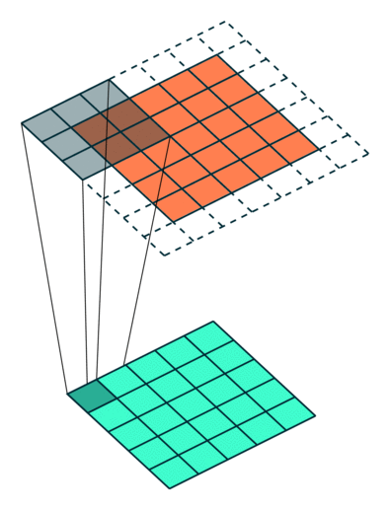
Convolution (“Conv2D” algorithm)
Weights from a filter are fit within a “window” (often 3x3) and strided across image, multiplying and accumulating values of weights and associated pixels and outputted to a “feature map”.
Input image in orange, output in green. Window is shown as shaded area.
Outlined region is beyond the dimensions of the image and are padded with zeros to keep the output map the same size as the input.
(No bias in this case.)

Slide 4
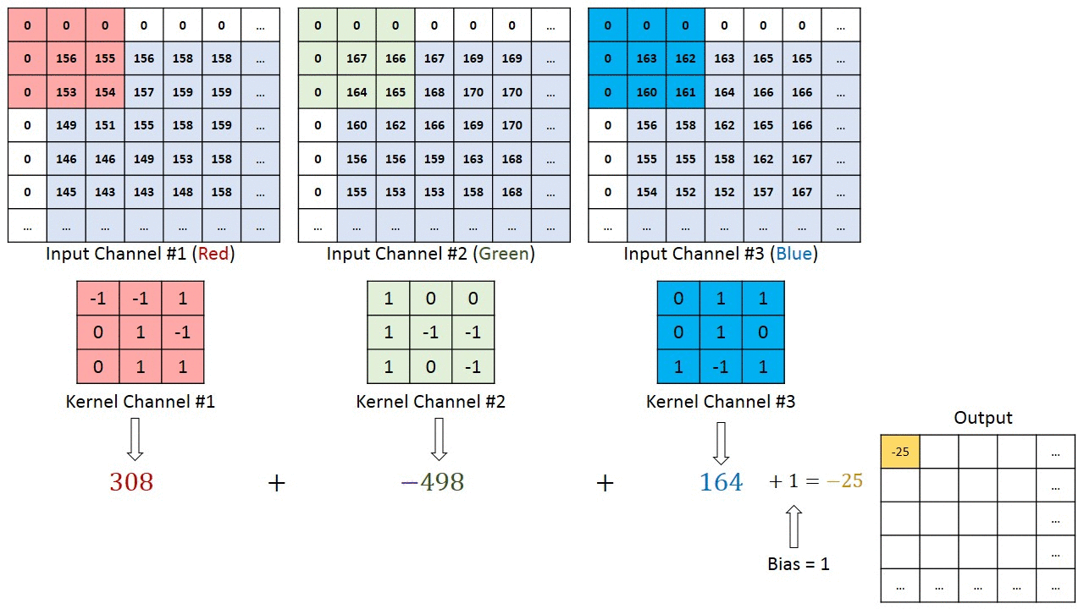
Convolution with multiple channels

Slide 5
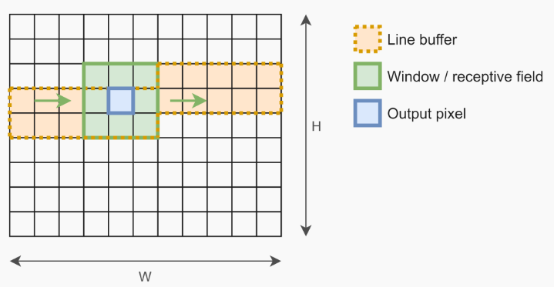
Design Evolution
Tried to “copy-paste” Darknet’s code into HLS
  Dumb, Darknet uses im2col algorithm which is unfriendly for HLS
Conv2D with window and line-buffer, but for 3 channels only
  Not very portable, only supports first layer
  3 rows for line buffer are used for simplicity
Per channel convolution, with “partial sum” input
  Result of multiply accumulate is added to partial sum input before being outputted
  Allows for any number of channels, but more overhead for streaming data in between them

Slide 6
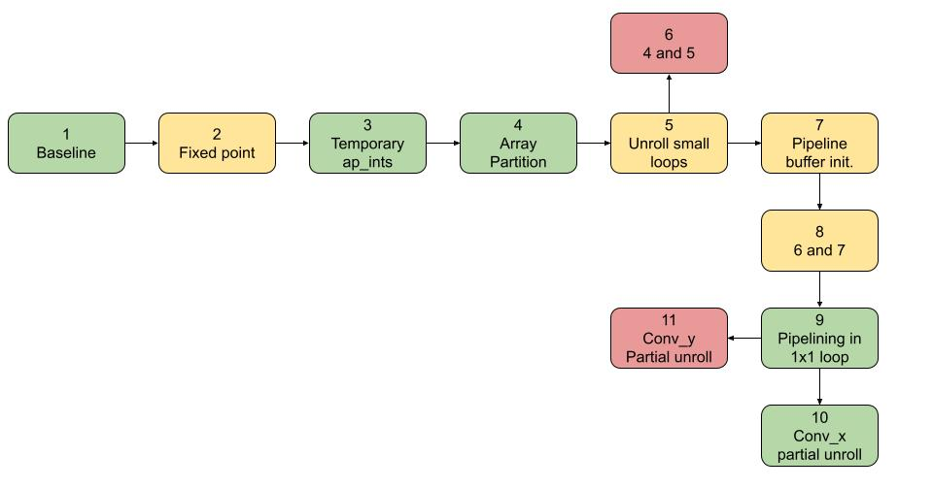
Optimizations

Slide 7
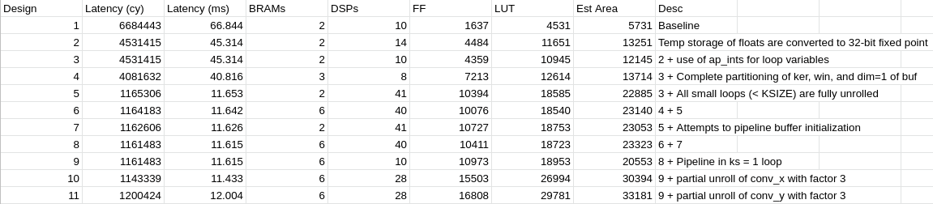
Data
Ultimately, design 9 was used as the cost in area from design 10 was too much for the small decrease in latency.

Slide 8
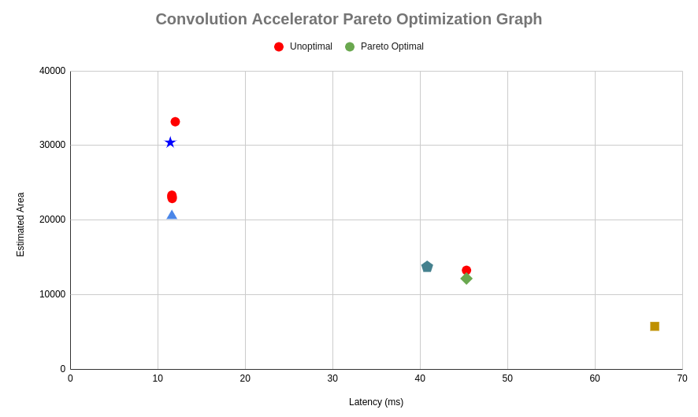
Pareto Optimal Graph

Slide 9
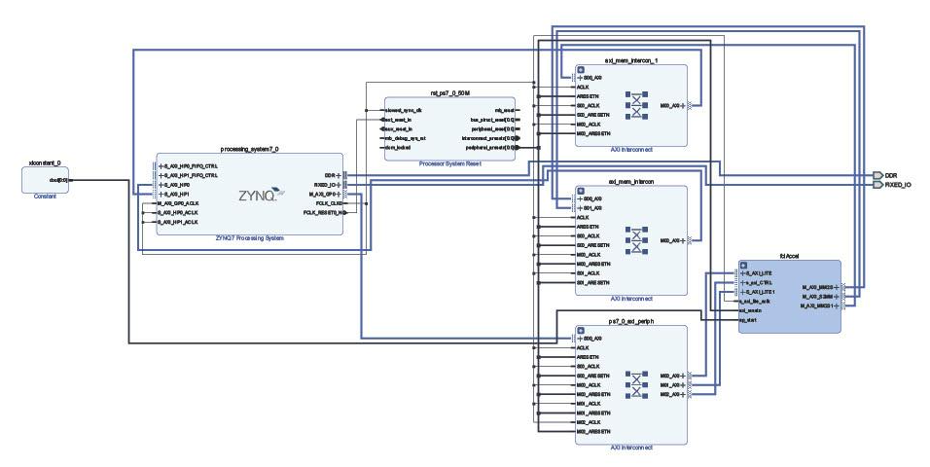
Block Diagram

Slide 10

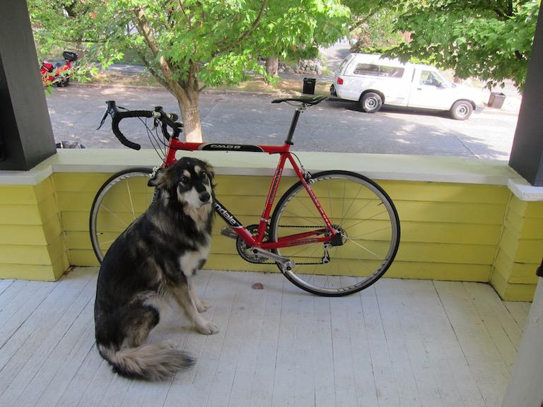
Testing
Performance test:
compared software and hardware implementations by convoluting predefined kernels across 3-channel image
Accuracy test:
runs hardware with data files ripped from test run from original Darknet framework and compares to expected output

Slide 11
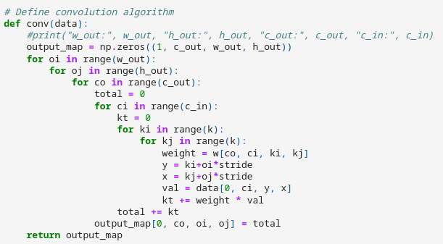
Performance Comparison
Software implementation used a similar algorithm, but not exact.
No window or line buffer as it wasn’t necessary

Slide 12
Performance Comparison
Software timing: about 44.55 seconds
Unoptimized hardware:
Optimized hardware:

Slide 13
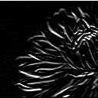
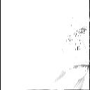
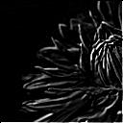
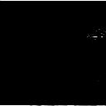

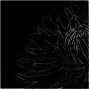
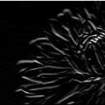
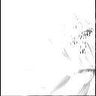
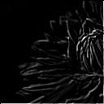
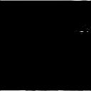

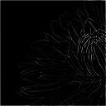
Output Feature Map Comparison
Unoptimized hardware
Software

Slide 14



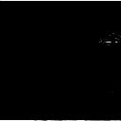


Output Feature Map Comparison
Unoptimized hardware
Optimized Hardware

Slide 15
Accuracy Testing
Data files created by extracting floating point values from inputs, weights, and outputs from the first layer of the tiny.cfg configuration when classifying dog.jpg.
The input files are read from and written to buffers that are sent through AXI-Stream interface.
The output generated by the hardware is compared value-by-value with the output data file, checking for discrepancies and calculating the average error (if any) for each filter.

Slide 16
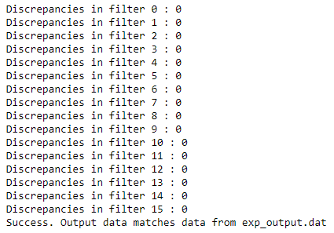
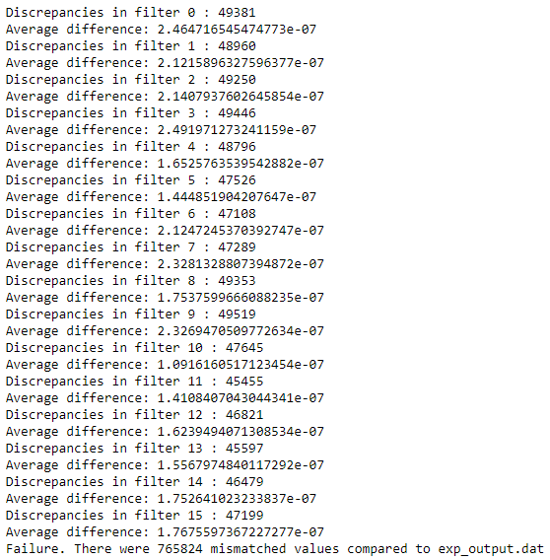
Accuracy Testing
Unoptimized hardware:
Optimized hardware:

Slide 17
Accuracy Testing
Unoptimized hardware will replicate output perfectly but optimized doesn’t?
Use of fixed-point values in optimized hardware may result in a slight compromise in accuracy.
But what about performance?
Unoptimized hardware:
Optimized hardware:
About 3.4 times speedup after optimization, 5.6 times when discounting loading overhead

Slide 18
Retrospection
Too much time wasted trying to hastily throw stuff together instead of spending time researching first
  First confirmed working design was created about 2 weeks ago
  Wasn’t too aware of difference between existing algorithms before start of this project
Too focused in compatibility
  Darknet’s algorithm was designed for software in mind, so the only compatibility that mattered was how inputs and outputs were organized
  Most of the time was spent rewriting code and validating against original Darknet output, time that could have been spent getting a “baseline” working to avoid future issues in implementation
  Didn’t implement fixed-point until yesterday
Optimized design still hilariously slow
  Takes hardware 3.55 seconds to complete only first layer, Lenovo T580 laptop can finish inferencing entirely with only CPU in 0.12 seconds
  Large latency can likely be attributed to latency filling buffers, latency from streaming data in between channels, and possibly from other areas of unoptimized design

Slide 19
Future Work
HLS-side basically done
  May explore some other minor options in HLS optimization
  Explore discrepancy in software and hardware feature maps
MBD-side still requires integration
  Use PYNQ static library to help allocate memory for DMA
    Originally going to use udmabuf kernel driver but can’t (cross-)compile
  Write user-level driver to be called within Darknet to interface hardware
  Run hardware accelerator if constraints match, Darknet’s im2col if not
  Compare performance between with and without accelerator

Slide 20
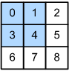
If I had more time…
Explore more “radical” methods to parallelize convolution
Split input image into equal parts and convolute over them
Research better methods of convolution for hardware
Keep data more local to reduce streaming and loading overhead
Redesign a modified version of “design 2” (per filter instead of per channel)
“Loopback” output data back into input data for partial sum
Expand capabilities of accelerator to allow variation in other parameters (stride, etc)

Slide 21
References
https://medium.datadriveninvestor.com/convolutional-neural-networks-3b241a5da51e
https://m-alcu.github.io/blog/2018/01/13/neural-layers/
https://towardsdatascience.com/convolutional-layer-hacking-with-python-and-numpy-e5f64812ca0c
https://pjreddie.com/darknet/
https://basile.be/2019/03/18/a-tutorial-on-non-separable-2d-convolutions-in-vivado-hls/

